Slide 1
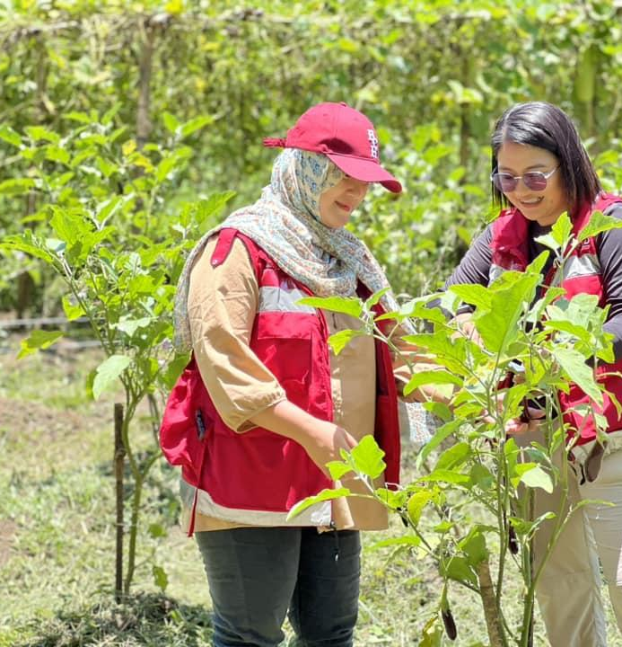


KliMalasakit Online Document Updating System (KODUS)
Knowledge Management Session
A Good Practice in Digital Innovation for RRP-CFTW LAWA and BINHI
#BawatBuhayMahalagaSaDSWD

Slide 2


Purpose of the Tool
Who is this for
KODUS streamlines document tracking, masterlist validation, deduplication, crossmatching, and disaggregated reporting for the implementation of RRP-CFTW under Projects LAWA and BINHI.
Designed for authorized DSWD Field Office Caraga personnel, including DRMD and RRP-CFTW implementers, validation staff, report generators, and program decision-makers who manage beneficiary and implementation data.
#BawatBuhayMahalagaSaDSWD

Slide 3
Context and Challenge
Before KODUS:
Manual spreadsheets and fragmented files slowed operations. Duplicate records and version conflicts weakened data integrity. Document tracking and masterlist validation were labor-intensive. Disaggregated reporting across municipalities took too much time.
What KODUS changed:
Centralized, secure, web-based internal system Real-time visibility of document and beneficiary workflows Automated validation, deduplication, and crossmatching Standardized outputs for reporting and monitoring
#BawatBuhayMahalagaSaDSWD

Slide 4
Core Functionalities
Track document flow across program phases Manage and validate the Masterlist of Eligible Partner-Beneficiaries
Run deduplication and crossmatching:
- KODUS Database vs File - File vs File
Generate sex-, age-, sector-, and barangay-disaggregated reports Monitor implementation status, partner beneficiaries, and compliance outputs
#BawatBuhayMahalagaSaDSWD

Slide 5
Pre-Implementation Phase
RRP-CFTW operations relied on manual spreadsheets and scattered trackers. Field staff spent significant time validating masterlists and reconciling records. Delays and inconsistencies affected reporting across multiple municipalities. DSWD FO Caraga identified the need for a secure, centralized, and automated internal platform.
KODUS was conceptualized to reduce operational bottlenecks while protecting sensitive beneficiary data.
#BawatBuhayMahalagaSaDSWD

Slide 6
Implementation Phase
Modules were configured to match LAWA and BINHI workflows. Authorized staff were oriented on system navigation and data protocols. Deduplication and crossmatching tools were rolled out to improve eligibility screening. Report filters automated demographic and sectoral summaries. Staff gained faster validation, stronger confidence in data, and quicker report turnaround.
KODUS supported real-time tracking, standardized outputs, and more efficient program monitoring.
#BawatBuhayMahalagaSaDSWD

Slide 7
Post-Implementation Enhancements
Added more reporting templates and geographic breakdowns Improved user interface and visual cues for field-level users Introduced audit logs and data integrity checks Continued refining features through user feedback Kept the platform responsive to emerging operational needs
#BawatBuhayMahalagaSaDSWD

Slide 8
Results and Impact
Quantitative gains:
Masterlist validation: 2-3 days to less than 1 day Document tracking accuracy: ~80% to 98-100% Beneficiary duplication rate: 0% Disaggregated reports: 1-2 hours to less than 15 minutes
Qualitative gains:
Reduced manual workload for staff Faster coordination across program phases Better evidence-based planning for sectors and vulnerable groups Stronger internal reporting consistency and data integrity
#BawatBuhayMahalagaSaDSWD

Slide 9
Lessons Learned and Replication
Lessons learned:
Orientation drives adoption. Restricted access strengthens accountability and data security. User feedback improves system functionality. Automation reduces reconciliation work and speeds up reporting.
Replication considerations:
KODUS is replicable across DSWD offices with similar workflows. Success requires technical stewardship, secure hosting, and documentation. Recommended next steps: readiness assessment, pilot rollout, feedback loop, and scaling documentation.
#BawatBuhayMahalagaSaDSWD

Slide 11
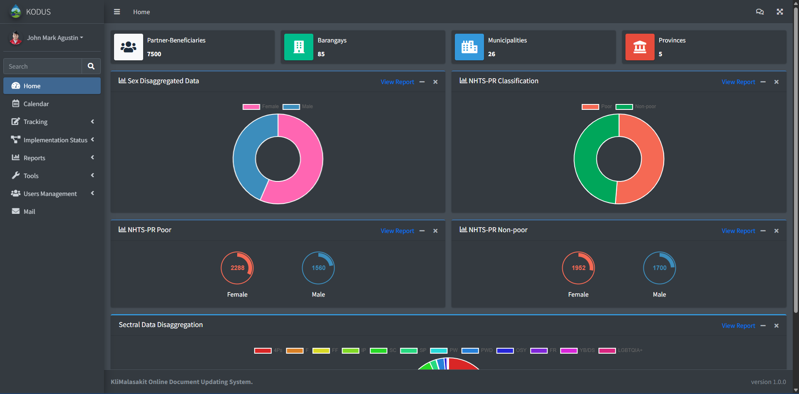
Dashboard
#BawatBuhayMahalagaSaDSWD

Slide 12
THANK YOU!
Questions and Discussion
Prepared by: John Mark Agustin E. Acido
Project Development Officer I | RRP-CFTW Budget Focal
KODUS: http://crg-co1-23-0028/kodus
#BawatBuhayMahalagaSaDSWD

